Slide 1
Deep Learning Project: Video Object Tracking
By:
Tom Steinman
Rohan Hashmi
Blake Simpson
Alexander Robinson

Slide 2
Project Tasks:
Data Processing, Data Augmentation – Tom
Faster R-CNN few-shot fine-tuning - Ron
Train the Siamese Network for Re-ID - Blake
Perform Detection and Re-ID for tracking - Alex

Slide 3
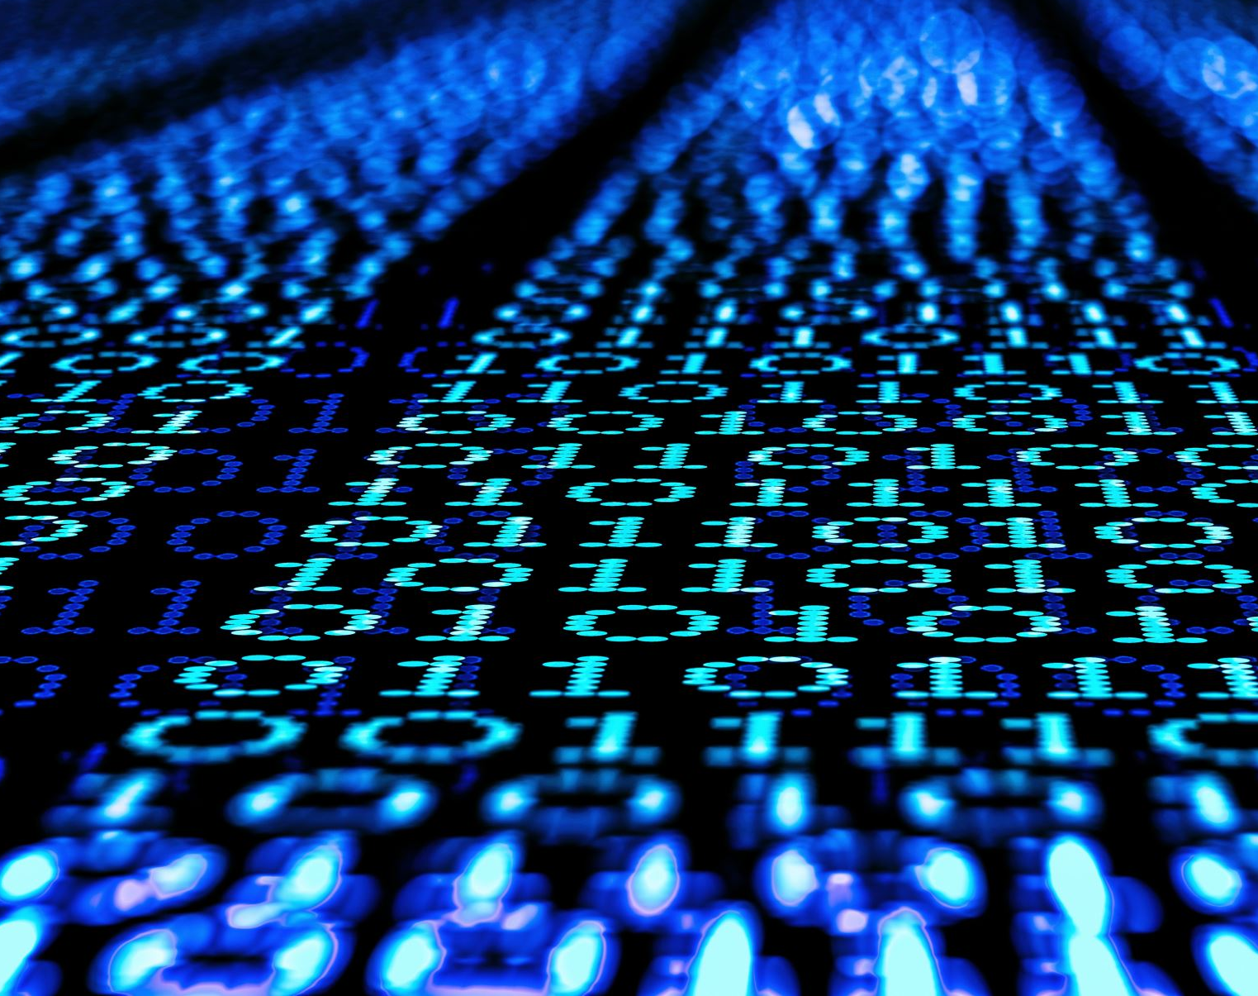
Data Processing & Data Augmentation
Dataset Import & Setup Mounted Google Drive, confirmed MOT16 train/ and test/ folders, and dynamically listed all sequences to prepare for train/validation split.
Configuration
All the rules to clean and augment in one place. Batch size, keep class for pedestrians only, minimum visible fraction, box size, CPU count setting for Colab
Parsing Map each frame id to track_id (where person is in each frame), x, y, w, h, class_id (id of object being tracked) as a dictionary
Bounding Box Processing Converted all boxes from top-left + width/height format to corner coordinates, and forced box corners to stay inside image bounds to avoid invalid training data.
Data Augmentation Applied color-based transformations like brightness, contrast jitter and Gaussian blur to improve model robustness, without changing object locations.
Loader & Sanity Checks Combined all sequences into training and validation sets, created data loaders with shuffling and batching, and visually inspected sample images with boxes to confirm correctness.
Training/Validation Split: by folders to prevent data leakage

Slide 4
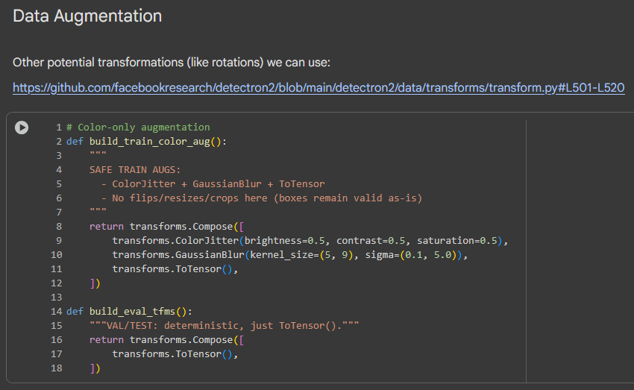
Data Augmentation to start:
ColorJitter
Randomly changes:
Brightness (±50%)
Contrast (±50%)
Saturation (±50%) -Helps simulate lighting variations and improve robustness to color shifts.
GaussianBlur
Applies a random blur with:
Kernel size randomly chosen between 5×5 and 9×9
Sigma (blur intensity) randomly between 0.1 and 5.0 -Helps the model generalize to out-of-focus or low-quality images.
ToTensor
Converts images (0–255) → PyTorch tensors (0–1 floats)

Slide 5
Faster R-CNN few-shot fine-tuning
Goal: Train a person detector (Faster R-CNN ResNet-50 FPN) to generate accurate bounding boxes for the tracking / Re-ID stages.
Model & optimization
fasterrcnn_resnet50_fpn (pretrained) → replaced head for 2 classes (person/background).
Backbone frozen (fewer params, faster / less overfit), trained heads.
Optimizer: SGD (lr 0.005, momentum 0.9, wd 5e-4).
LR schedule: milestones at 6 & 10 (×0.1).
Checkpoints & logs
Saved best and last; can resume training.
Logged per epoch: train_loss, val_recall@0.5, time, lr.
Notes:
After data augmentation we trained the detector - the Faster R-CNN with a ResNet-50 FPN backbone. Its main goal was to find and draw boxes around people in every frame so later stages, like tracking and re-identification, have input to work with.
we started with a pretrained model and fine-tuned it for just two classes: person and background. To make training faster and more stable, We froze the backbone that’s the feature extractor and trained only the top classification and box-prediction layers.
The optimizer we used was SGD with:
learning rate = 0.005
momentum = 0.9
weight decay = 5×10⁻⁴
The learning rate drops at epochs 6 and 10 by a factor of 0.1 to help it converge smoothly.
we saved both best and last checkpoints so training could resume later and logged metrics like loss, recall, and time per epoch.

Slide 6
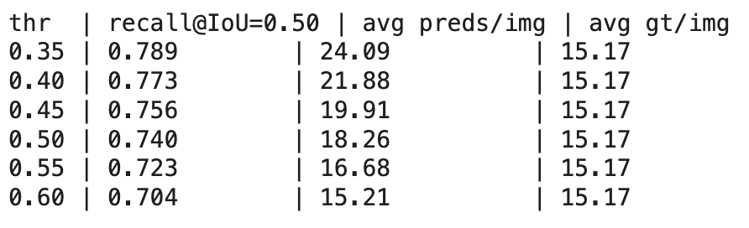
Validation & Threshold Sweep (Post-train)
Metric: Recall@IoU=0.5 = fraction of ground-truth people that have a matched prediction (IoU ≥ 0.5).
Why a sweep?: The model outputs a score per box. We try several score thresholds and pick the one that gives the best recall on val.
Chosen: score_thresh = 0.35 (highest recall).
Notes:
After training, we validated how well the detector worked. The main metric we used was Recall @ IoU = 0.5 that means, for each frame, how many real people were correctly detected with at least 50% overlap between the predicted box and the ground truth.
IoU stands for Intersection over Union - it measures how much two boxes overlap. 1.0 means perfect overlap, 0 means none.
we tested multiple score thresholds - 0.35, 0.4, 0.45, etc. The threshold controls how confident the model must be to keep a box. Lower thresholds keep more boxes (catching almost everyone but adding false positives). Higher thresholds keep fewer boxes (cleaner results but might miss people).
As shown in the table, a threshold of 0.35 gave the best recall (≈0.79), so we ended up using that.
That means at 0.35 confidence, the detector catches almost every person, which is ideal for tracking

Slide 7
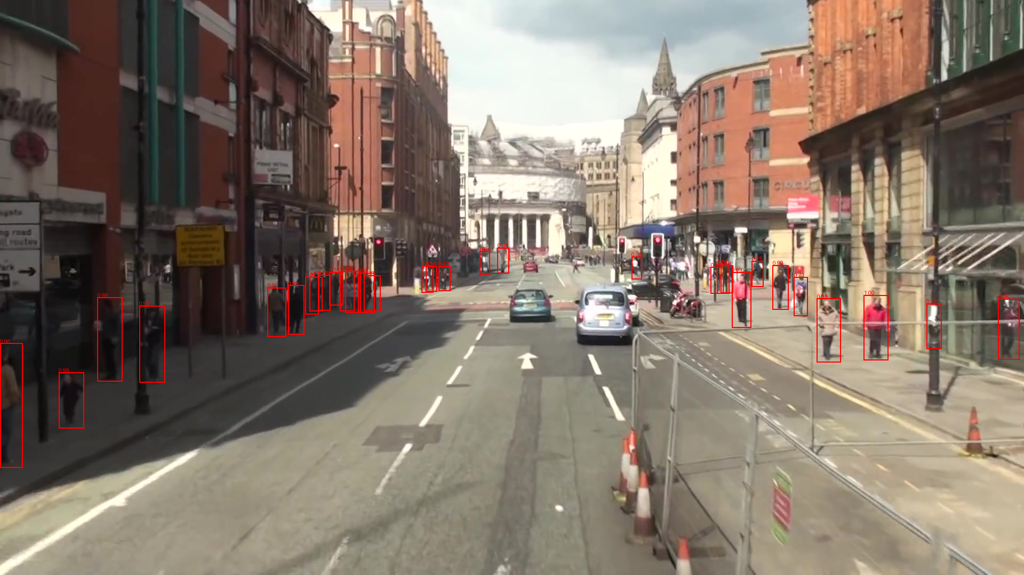
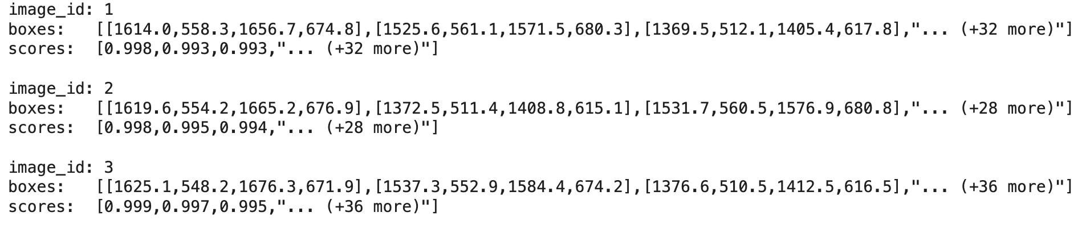
Outputs & Handoff to Tracking/Re-ID
What was produced:
checkpoints/ - fasterrcnn_best.pt, fasterrcnn_last.pt
samples/ - a few val frames with predicted boxes
training_log.json - {epoch, train_loss, val_recall, sec, lr}
detections_val.jsonl - 1 line per frame (post-NMS, thresholded)
Notes:
Once we had the trained detector, we prepared all the outputs needed by the next stages.
we saved:
the best and last model weights (for resuming or comparing checkpoints),
several validation sample images showing detected boxes,
and a training_log.json that records loss, recall, and timing per epoch.
The key output is detections_val.jsonl, which stores results for each frame it lists:
the image_id,
all detected box coordinates,
and their confidence scores.
That JSONL file becomes the input for the tracking and re-identification components. Those modules take these detections and start following each person across frames using motion and appearance cues.

Slide 8
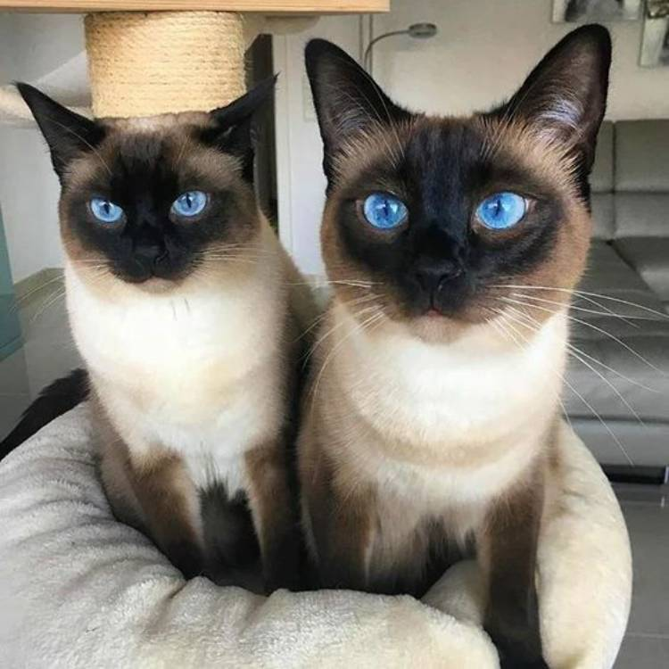
Siamese Network for Re-Identification
Goal:
Enable the model to consistently recognize the same person across multiple video frames using learned appearance embeddings.
Pipeline
Faster R-CNN detects people and outputs bounding boxes per frame
Cropped detections are passed into the Siamese Network
The Siamese Network generates embeddings for each person instance
Embeddings are compared to determine identity consistency across frames
Training
^{Trained using Triplet Loss:}
^{Anchor: one person image}
Positive: same person, different frame
^{Negative: different person}
Optimizes the feature space so:
^{Same person → embeddings close}
Different people → embeddings far apart
20 epochs on the cropped MOT16 training set
Output: fixed-length embedding per person used for cross-frame matching
Notes:
Siamese networks use 2 branches of identical subnetworks that contain the same weights. This is so 2 images can be processed simultaneously. This 2 identical branch structure is what makes it adept at similarity instead of classification.

Slide 9
Siamese Network – Results & Performance
Training convergence
Trained for 20 epochs on MOT16 cropped person images
Triplet loss decreased from 0.0467 → 0.0096
That’s roughly an 80% reduction in loss, indicating the network learned a discriminative embedding space
Training behavior
Early epochs were slow (up to ~29 minutes) as data was first read from Google Drive
Later epochs stabilized to ~1–5 minutes per epoch as caching and I/O improved
Overall training finished successfully and the final model weights were saved as `siamese_osnet_best.pt`
Data issues & robustness
Some cropped images were corrupted / unreadable in MOT16
Training loop handled these gracefully with dummy tensors, so training did not crash
Shows the pipeline can tolerate noisy / imperfect real-world data in the dataset
Observed Limitations
Identity stability degrades during partial or full occlusion
When a person is temporarily obscured, the system may reassign a new ID upon reappearance
This behavior is common in appearance-only Re-ID systems without motion modeling

Slide 10
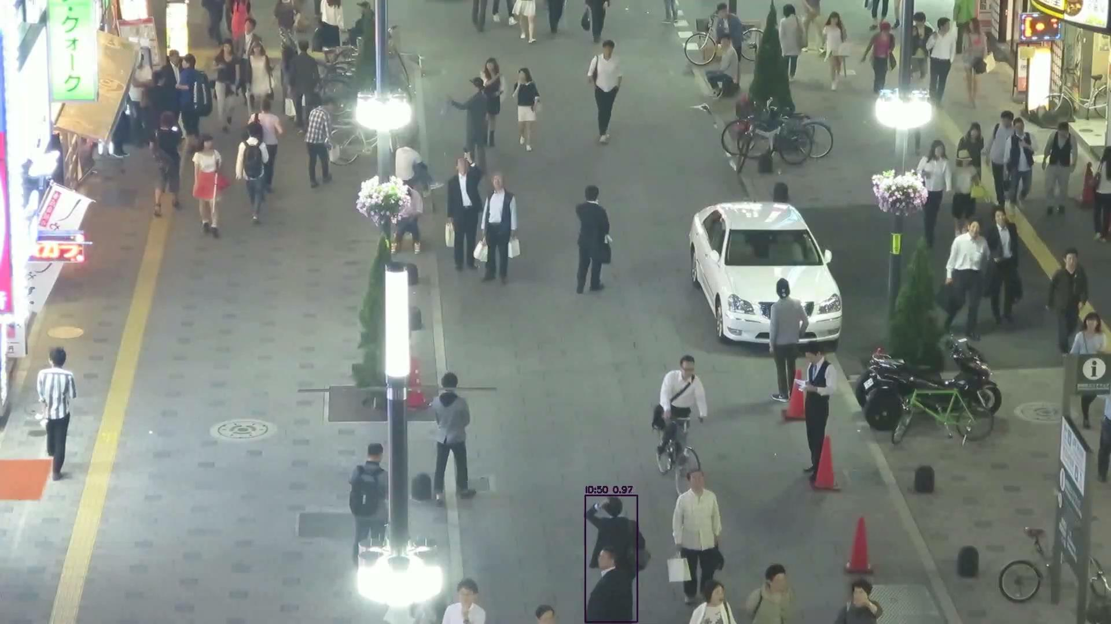
Siamese Network – Initial Output

Slide 11
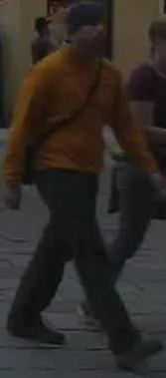
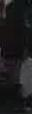
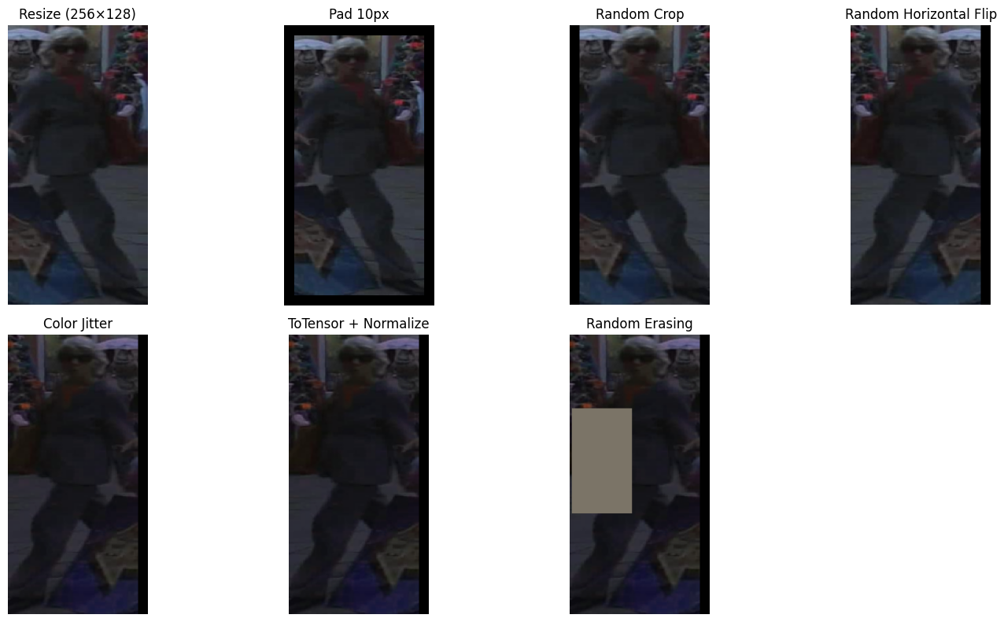
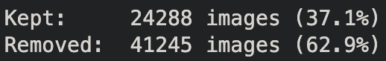
Siamese Network – Attempted Improvements
Data Cleaning
We took the cropped images of the people and ran them through the Faster R-Cnn to ensure the data looked like a person.
Data Augmentation
Implemented random horizontal flipping, color jitter, random cropping, and random erasing.
To save space and reduce the model seeing the same samples, the data is augmented on the fly

Slide 12
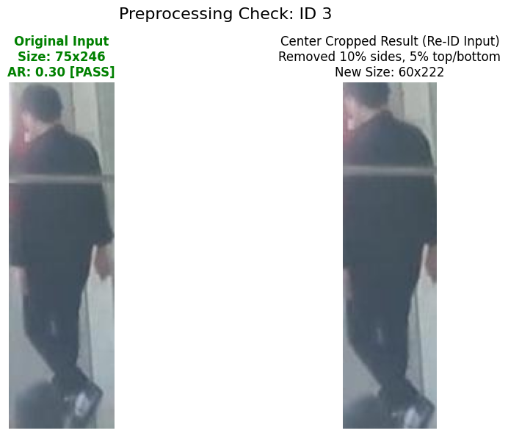
Siamese Network – Attempted Improvements
Post Processing
^{Aspect Ratio Filter}
^{Center Cropping}
Tracking logic
^{Kalman Filter}
Takes in position data to estimate velocity
If the estimation is far from ground truth then update velocity.
^{Hungarian Matching}
^{Optimizes a cost matrix.}
Cost is Distance and Appearance.
Finds combination of images from Kalman estimation and actual prediction that minimize cost of all images globally.

Slide 13
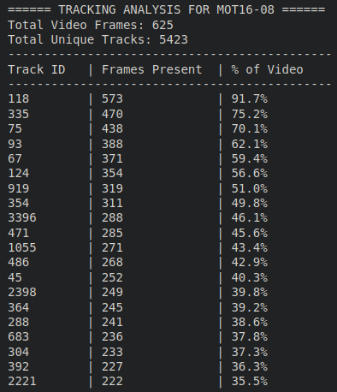
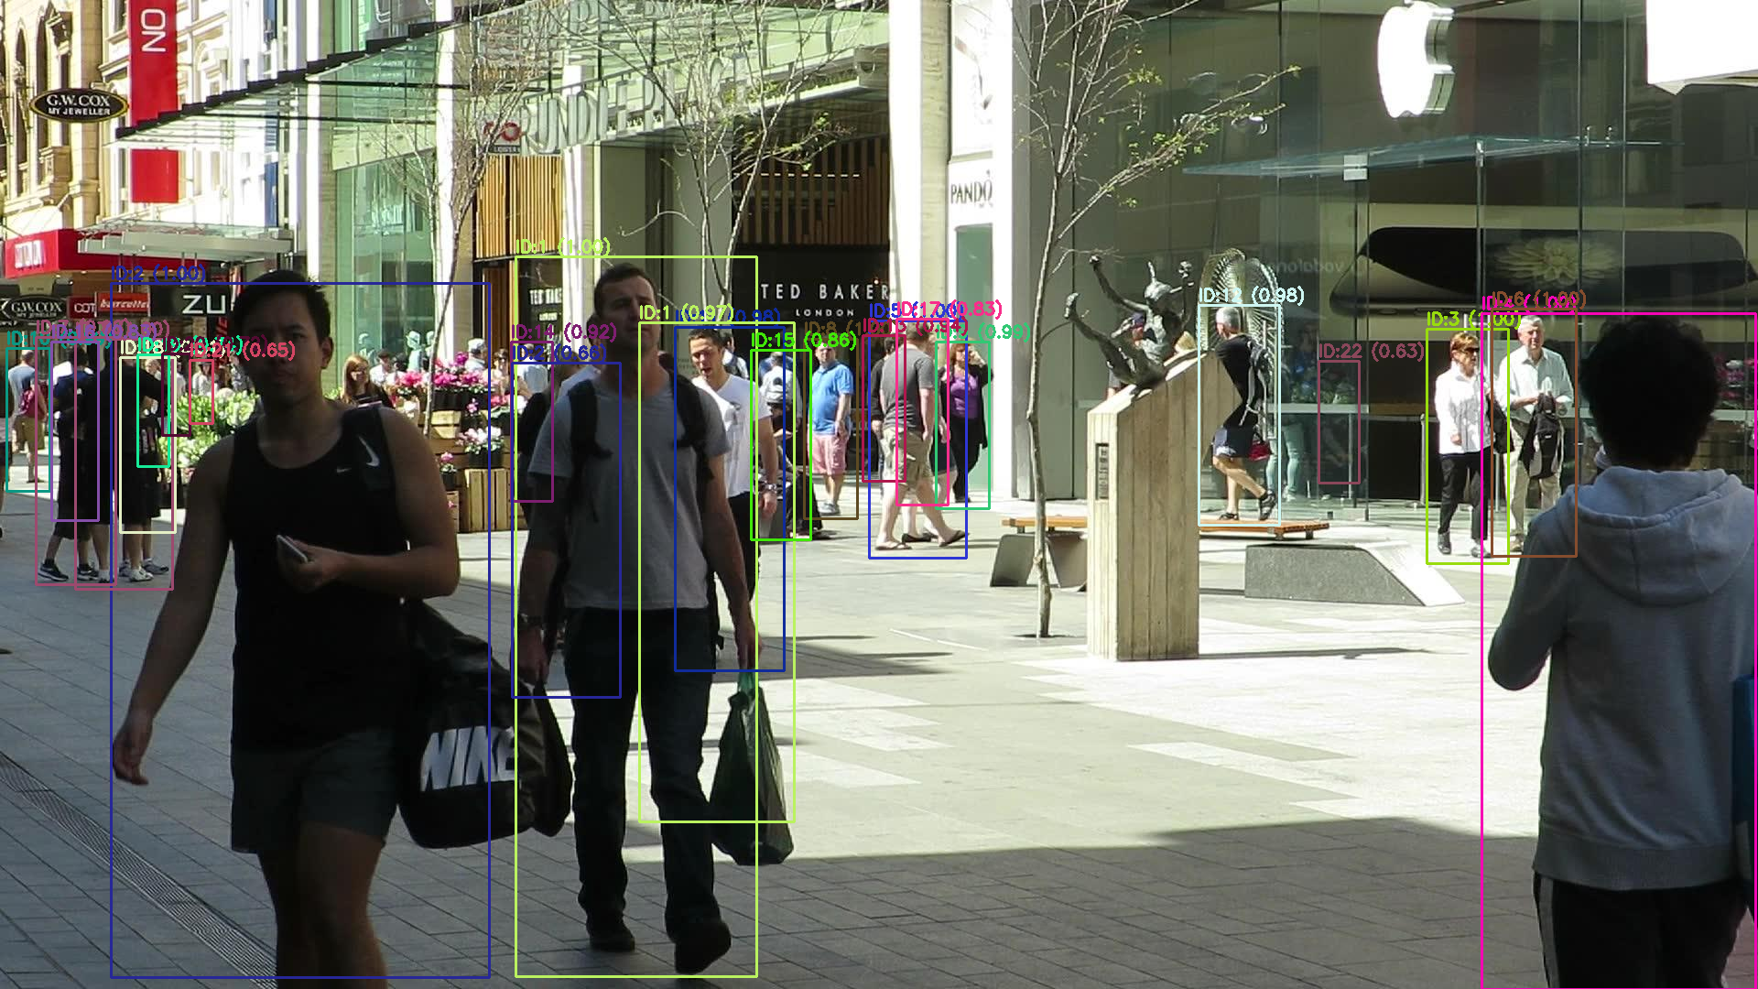
Video Generation
At first, we ran inference every time
A tool was created to try to find good candidates to track.

Slide 14


Video Generation
At first, we ran inference every time
A tool was created to try to find good candidates to track.
We computed inference only once
Time went from ~30 mins to ~20 seconds

Slide 15
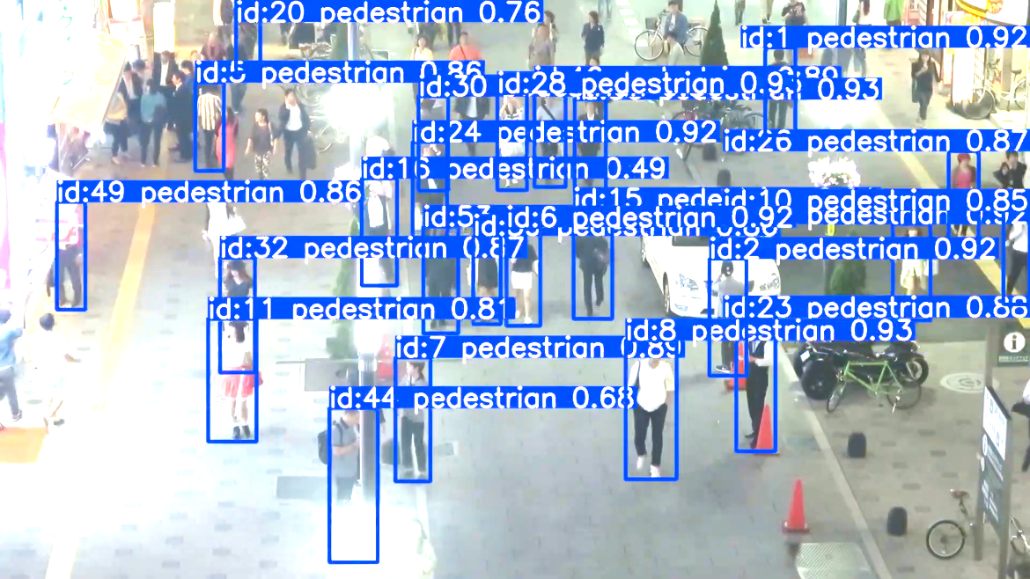
YOLO Implementation
Attempt 1: YOLO detection + default tracking
YOLOv8 detection with built-in tracker defaults
Tested ByteTrack (fast) vs BoT-SORT (more stable)
Problems observed with ByteTrack:
Too many detections depending on thresholds
Identity instability during occlusion in crowded frames
Excellent for quantity over quality, but not single IDs
ByteTrack
Pros: very fast, simple
Cons: can produce more ID switches in dense/occluded scenes
BoT-SORT
Pros: stronger identity persistence in challenging scenes
Cons: heavier compute, still sensitive to occlusion duration
Why we chose BoT-SORT
Requirement is ID persistence through occlusion: stability matters more than speed.
ByteTrack Example

Slide 16
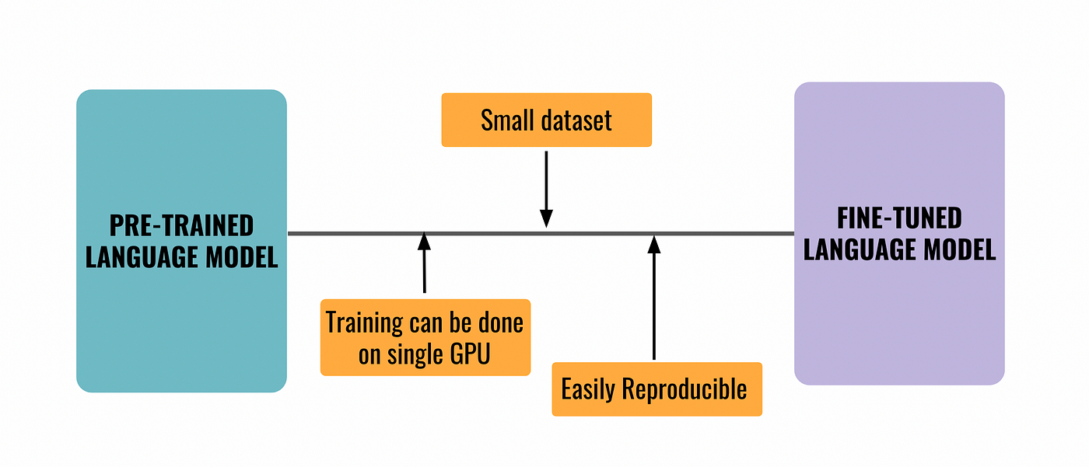

YOLO Fine Tuning
BoT-SORT Customization for Occlusion
We copy Ultralytics default BoT-SORT config
Source: ultralytics/cfg/trackers/botsort.yaml
Parameters tuned
track_buffer = 120
keeps a track “alive” longer when target is hidden
match_thresh = 0.7
balances re-association vs ID switches
Tuned threshholds:
proximity_thresh = 0.2
appearance_thresh = 0.3
Single-Person Output:
Goal
Produce a demo video that visually proves:
ID 15 moves behind an object
ID 15 reappears with the same ID
Implementation
Track entire scene with BoT-SORT
During rendering:
draw boxes only when tid == 15
save to id15_tracking_demo.mp4
Notes:
The key improvement for occlusion is increasing track_buffer so short occlusions don’t immediately kill the identity.

Slide 17


Siamese Network vs YOLO
Siamese Network
YOLO

Slide 18
Thank you

